Slide 1
Simple Rules for Complex Times
CBODN
April 30, 2010
Glenda Eoyang, Ph.D.
geoyang@HSDInstitute.org

Slide 2
Today We Will . . .
Distinguish between traditional, linear change and emergent, complex adaptive change processes
Recognize the power of simple rules to inspire creative, collective responses
Practice developing a short list of simple rules to guide your practice and your client’s productivity

Slide 3
Complex Adaptive System (CAS) Self-Organizing System
A collection of individual agents who have the freedom to act in unpredictable ways, and whose actions are interconnected such that they produce system-wide patterns.
Agents interact

Slide 4
Complex Adaptive System (CAS) Self-Organizing System
Those system-wide patterns, in turn, influence the behaviors of the agents
System-wide patterns emerge
Agents interact

Slide 5
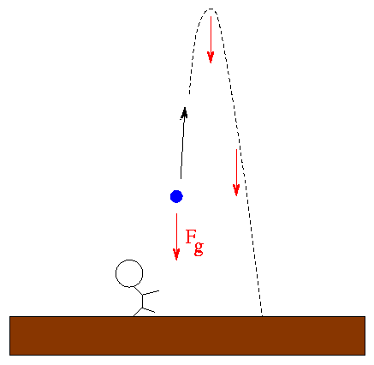
Static, Dynamic, Dynamical Change
Static Change
Dynamic Change
Dynamical Change

Slide 6
Short List of Simple Rules
Generates coherence with minimum constraint
Supports adaptation over time
Builds connection across and within all levels
Creates “family resemblance”
Works retrospectively or prospectively

Slide 7
Short List of Simple Rules Tips and Traps
These are not values–they tell you what to DO, not what to think or feel
These are not group norms– they hold over space and time
Sometimes the rules contradict each other (this isn’t bad, it just means the group will live with ambiguity)
The “rules” depend on individual freedom to interpret and apply in unique situations
Else?

Slide 8
Short List of Simple Rules
Rules for simple rules:
Include no more than 5 (+ or -2)
Begin with a verb
Work for everyone and every place in the system
Need at least one rule for each of the conditions for self-organizing:
Who are we?
What’s important to us?
How do we work interact?

Slide 9
Human Systems Dynamics
Short List of Simple Rules
Teach and learn in every interaction
Reinforce strength of self and others
Search for the true and the useful
Attend to the whole, the part, and the greater whole
Give and get value for value
Engage in joyful practice

Slide 10
Short List of Simple Rules Practice
Work together to write a short list of simple rules for leading transformation in complex times.
How would you change the rules to build patterns where transformation was more:
Fast
Flexible
Creative
Healthy
Intelligent
Successful in the marketplace

Slide 11
For more information . . .
www.hsdinstitute.org
Books
Facilitating Organization Change: Lessons from Complexity Science (Olson & Eoyang)
Coping with Chaos: Seven Simple Tools (Eoyang)
Influencing Patterns for Change (Holladay & Quade)
Classes and workshops

Slide 12
Today We Have . . .
Distinguished between traditional, linear change and emergent, complex adaptive change processes
Recognized the power of simple rules to inspire creative, collective responses
Practiced developing a short list of simple rules to guide your practice and your client’s productivity

Slide 13
Press Esc to end session

